Slide 1

Deep Learning Regularization and Propagation Techniques
This presentation explores essential concepts in deep learning, focusing on regularization techniques, forward and backward propagation, and computational graphs.
These foundational topics are crucial for understanding how neural networks learn and generalize from data.
We'll dive into methods like weight decay and dropout that help prevent overfitting, examine the mathematics behind forward and backward passes through networks, and visualize the computational structures underlying these processes.

Slide 2

Mastering Regularization Techniques
Regularization techniques are essential for preventing overfitting in machine learning models, leading to improved generalization and performance.
Ec

Slide 3
Introduction to Regularization
Regularization is a critical concept in deep learning, serving as a safeguard against overfitting and enhancing a model's ability to generalize to unseen data.
As neural networks become increasingly complex, they risk memorizing the training data rather than learning meaningful patterns. This phenomenon, known as overfitting, leads to poor performance on new, unseen examples.
Regularization techniques introduce constraints or penalties that discourage the model from relying too heavily on any particular feature or weight. By doing so, they promote simpler, more robust models that capture the underlying patterns in the data without being overly sensitive to noise or outliers in the training set.
1
Prevent Overfitting
2
Improve Generalization
Regularization techniques help prevent the model from becoming too complex and fitting noise in the training data.
By promoting simpler models, regularization enhances the ability to perform well on unseen data.
Robustness
3
Balance Complexity
4
Regularization helps find the optimal balance between model complexity and performance on the training set.
Regularized models are often more robust to variations in input data and noise.

Slide 4
Types of Regularization
There are several regularization techniques commonly used in deep learning, each with its unique approach to preventing overfitting.
Two of the most prominent methods are
weight decay (L2 regularization)
and dropout.
Weight decay works by penalizing large weights in the model, effectively shrinking them towards zero. This encourages the model to use all of its inputs in moderation rather than relying too heavily on any particular feature.
Dropout, on the other hand, randomly deactivates a subset of neurons during training, forcing the network to learn more robust features that don't rely on the presence of specific other features. Other techniques include L1 regularization, early stopping, and data augmentation.
Weight Decay (L2)
Dropout
Other Techniques
Penalizes large weights by adding an L2 penalty term to the loss function.
Randomly deactivates neurons during training to prevent co-adaptation.
Includes L1 regularization, early stopping, and data augmentation for diverse approaches to regularization.

Slide 5

Introduction to Regularization
Overfitting
Generalization
Model Complexity
When a model learns the training data too well, it can perform poorly on unseen data.
Regularization helps models learn general patterns in the data, improving their performance on new data.
Regularization techniques aim to reduce the complexity of the model to prevent overfitting.

Slide 6

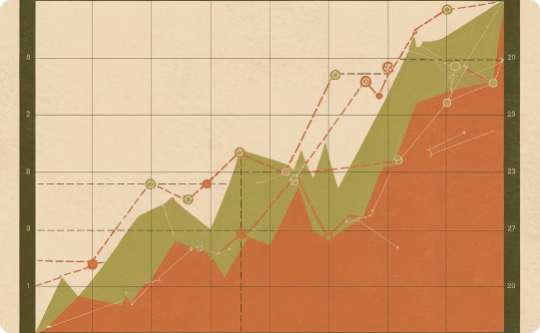
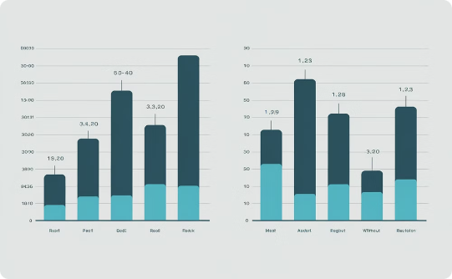
Importance of Regularization in Machine Learning
Preventing Overfitting
Improving Generalization
Enhancing Robustness
Regularization techniques reduce overfitting by penalizing overly complex models.
Regularization enhances a model's ability to perform well on unseen data.
Regularized models are less susceptible to noisy data and outliers.

Slide 7

Understanding Underfitting and Overfitting
Underfitting occurs when a model is too simple and fails to capture the underlying patterns in the data. This results in high bias and poor predictive accuracy.
Overfitting occurs when a model is too complex and learns the training data too well, leading to poor generalization on unseen data. This results in high variance and poor performance on new data.

Slide 8
Common Regularization Techniques
L1 Regularization (Lasso)
L2 Regularization (Ridge)
Dropout
Early Stopping
Dropout is a technique that randomly deactivates neurons during training. This forces the network to learn more robust features, reducing overreliance on specific neurons and improving generalization.
Early stopping monitors the model's performance on a validation set and stops training when the performance starts to deteriorate, preventing overfitting by halting training before the model becomes too complex.
L1 regularization adds a penalty to the sum of absolute values of weights. It encourages sparsity by driving some weights towards zero, effectively selecting the most relevant features.
L2 regularization adds a penalty proportional to the square of the weights. It shrinks the weights towards zero, preventing them from becoming too large and reducing the risk of overfitting.

Slide 9

Weight Decay
1
Regularization Technique
2
Shrinking Weights
It encourages the model to learn smaller weights, reducing the complexity and preventing overfitting.
Weight decay adds a penalty term to the loss function, proportional to the squared magnitude of the model's weights.
3
L2 Regularization
Weight decay is also known as L2 regularization due to the use of the squared L2 norm of the weights in the penalty term.

Slide 10
Weight Decay (L2 Regularization)
Weight decay, also known as L2 regularization, is a fundamental technique for preventing overfitting in neural networks. It works by adding a penalty term to the loss function that is proportional to the sum of the squares of all the weight parameters in the network. This encourages the network to use all of its inputs in moderation rather than relying on a small number of input features.
The mathematical representation of weight decay is straightforward. If we denote our original loss function as L_0, the regularized loss
function L becomes:
L = L_0 + λ * (1/2) * Σ(w^2)
Here, λ (lambda) is the regularization strength, a hyperparameter that controls the impact of the regularization term. The sum Σ(w^2) is taken over all weight parameters w in the network.
Original Loss
1
Start with the standard loss function based on model predictions and true labels.
2
Add Penalty Term
Incorporate the sum of squared weights multiplied by the regularization strength.
Optimize New Loss
3
Minimize the combined loss function during training to balance performance and weight magnitude.
4
Update Weights
The gradient descent step now includes an additional term that shrinks weights proportionally to their size.

Slide 11
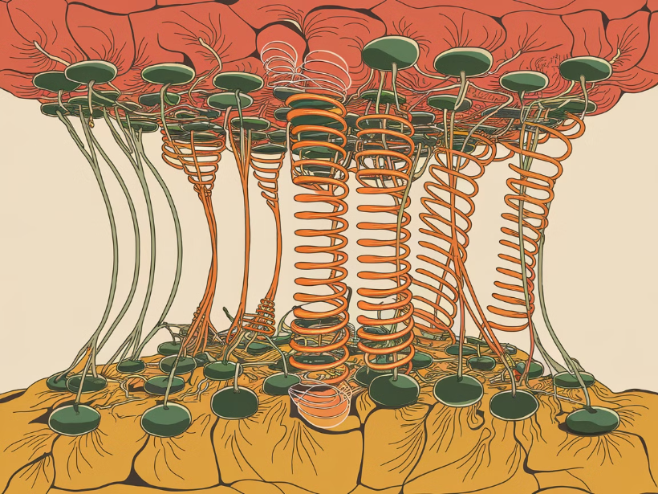
Intuition behind Weight Decay
Weight decay encourages models to learn smaller weights, reducing the model's complexity.
Smaller weights generally lead to smoother decision boundaries, mitigating the risk of overfitting.
This approach aims to prevent the model from relying too heavily on individual features, promoting a more balanced consideration of all input variables.

Slide 12
Mathematical Formulation of Weight Decay
Weight decay is a common regularization technique that penalizes large weights in a neural network. It aims to prevent overfitting by shrinking the magnitude of weights during training. This technique adds a penalty term to the loss function, which is proportional to the squared magnitude of the weights. The penalty term discourages the model from assigning excessively large weights to any specific feature.
The mathematical formulation of weight decay can be expressed as follows: Let W represent the weight matrix of a neural network. The weight decay penalty term is given by: λ/2 * ||W||^2, where λ is the regularization strength and ||W||^2 denotes the squared Frobenius norm of the weight matrix. The Frobenius norm measures the magnitude of the weight matrix. This penalty term is added to the loss function during training, and the model is optimized to minimize the total loss, which includes the original loss and the weight decay penalty.

Slide 13
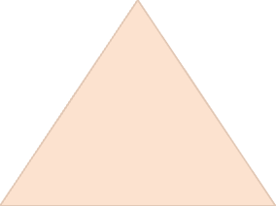

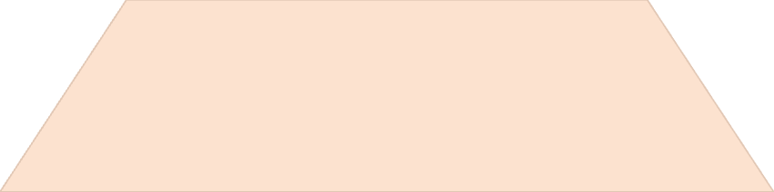
Implementing Weight Decay in Code
Weight decay is a simple yet effective regularization technique that can be easily implemented in popular machine learning libraries like TensorFlow and PyTorch.
Define the Regularization Parameter
1
The regularization parameter (lambda) controls the strength of weight decay.
Calculate the Loss Function
2
Add a penalty term to the original loss function, proportional to the sum of squared weights.
Update Weights
3
During backpropagation, adjust the weight updates to incorporate the weight decay penalty.

Slide 14
Implementing Weight Decay
Implementing weight decay in modern deep learning frameworks is straightforward. Most optimizers include a weight decay parameter that can be set during initialization. Here's an example using PyTorch:
import torch import torch.nn as nn import torch.optim as optim # Define the model model = nn.Sequential( nn.Linear(10, 5), nn.ReLU(), nn.Linear(5, 1) ) # Create the optimizer with weight decay optimizer = optim.SGD(model.parameters(), lr=0.01, weight_decay=0.01) # Training loop for epoch in range(num_epochs): for inputs, targets in dataloader: optimizer.zero_grad() outputs = model(inputs) loss = criterion(outputs, targets) loss.backward() optimizer.step()
In this example, we set weight_decay=0.01 in the optimizer, which applies L2 regularization with a strength of 0.01 to all parameters.
Model Definition
Optimizer Setup
Create a simple neural network using PyTorch's nn.Sequential.
Initialize the SGD optimizer with a learning rate and weight decay parameter.
Training Loop
Automatic Application
Implement a basic training loop that applies weight decay during optimization.
The weight decay is automatically applied to all parameters during the optimization step.

Slide 15




Impact of Weight Decay on Training
Weight decay has a significant impact on the training dynamics of neural networks. By penalizing large weights, it encourages the model to find solutions that use smaller weight values. This has several important effects:
1. Smoother Decision Boundaries: Smaller weights lead to smoother decision boundaries, which are often more generalizable.
2. Feature Selection: Weight decay can act as a form of feature selection, effectively reducing the impact of less important features.
3. Improved Conditioning: It can help improve the conditioning of the optimization problem, potentially leading to faster convergence.
4. Stability: Models with smaller weights are often more numerically stable during training.
Initial Large Weights
Gradual Shrinkage
Balanced Optimization
Final Compact Model
The model starts with potentially large, random weight initializations.
During training, weight decay continuously pushes weights towards smaller values.
The model finds a balance between minimizing the loss and keeping weights small.
The trained model has smaller weights and potentially better generalization.

Slide 16



Dropout
Randomized Neuron Deactivation
Dropout randomly deactivates a fraction of neurons during training.
Network Simplification
By removing neurons, dropout forces the network to learn more robust features.
Enhanced Generalization
Dropout prevents overfitting by reducing dependence on specific neurons.

Slide 17

Intuition behind Dropout
Dropout randomly deactivates a portion of neurons during training. This prevents neurons from becoming overly reliant on each other.
By forcing neurons to learn independently, dropout reduces overfitting and improves model generalization.

Slide 18

Dropout as a Regularization Technique
Randomly Deactivating Neurons
Ensembling Effect
Combating Overfitting
Dropout creates multiple "smaller" networks by randomly dropping neurons, leading to a form of ensemble learning, improving model generalization.
By forcing the model to learn more robust representations, dropout prevents overfitting and enhances its ability to generalize to unseen data.
During training, dropout randomly disables a proportion of neurons in each layer, preventing co-adaptation and reducing reliance on specific neurons.

Slide 19
Dropout: Concept and Motivation
Dropout is a powerful regularization technique introduced by Hinton et al. in 2012. The core idea behind dropout is surprisingly simple yet effective: during training, randomly "drop out" (i.e., set to zero) a proportion of neurons in each layer. This process creates an ensemble effect, as each training iteration effectively trains a slightly different network.
The motivation behind dropout stems from the observation that complex co-adaptations of neurons can lead to overfitting. By randomly removing neurons, the network is forced to learn more robust features that don't rely on the presence of specific other features. This reduces the network's sensitivity to specific weights and makes it more capable of generalizing to new data.
1
Random Deactivation
2
Ensemble Effect
Neurons are randomly turned off during each training iteration, creating a different effective network architecture.
Dropout simulates training an ensemble of multiple networks, improving generalization.
3
Reduced Co-adaptation
4
Noise Injection
Prevents neurons from relying too heavily on specific other neurons, encouraging more robust feature learning.
Acts as a form of noise injection, making the network more robust to variations in input.

Slide 20
Mathematics of Dropout
The mathematics behind dropout involve introducing a binary "mask" to each layer during forward propagation. Let's consider a single neuron with inputs x_1, ..., x_n and weights w_1, ..., w_n. Normally, its output y would be computed as:
y = f(Σ(w_i * x_i) + b)
where f is the activation function and b is the bias. With dropout, we introduce a vector of independent Bernoulli random variables r_1, ..., r_n, each with probability p of being 1 (kept) and 1-p of being 0 (dropped). The output with dropout becomes:
y = f(Σ(w_i * r_i * x_i) + b)
During testing, we use the expected value of this operation, which is equivalent to using all neurons but scaling their outputs by p:
y_test = f(p * Σ(w_i * x_i) + b)
Stage
Equation
Description
Normal
y = f(Σ(w_i * x_i) + b)
Standard neuron output
Dropout (Train)
y = f(Σ(w_i * r_i * x_i) + b)
Output with random dropout
Dropout (Test)
y = f(p * Σ(w_i * x_i) + b)
Expected output for inference

Slide 21





Implementing Dropout in Neural Networks
Randomly Deactivate Neurons
Dropout randomly removes a percentage of neurons during training. This disrupts the network, preventing overdependence on specific neurons.
Forward Pass with Masked Neurons
The forward pass is computed as usual, but the deactivated neurons don't contribute to the output.
Backpropagation with Masked Gradients
Gradients are calculated only for active neurons, propagating the error signal through the active network.
Training with Dropped Connections
Training occurs with multiple network configurations, promoting robustness and generalization.
Scaling Weights Back
During testing, all neurons are active, and the output weights are scaled to compensate for the dropout effect.

Slide 22
Implementing Dropout
Implementing dropout in modern deep learning frameworks is straightforward. Most frameworks provide built-in dropout layers that can be easily inserted into your network architecture. Here's an example using PyTorch:
import torch import torch.nn as nn class DropoutNet(nn.Module): def __init__(self, input_size, hidden_size, output_size, dropout_prob): super(DropoutNet, self).__init__() self.layer1 = nn.Linear(input_size, hidden_size) self.dropout = nn.Dropout(p=dropout_prob) self.layer2 = nn.Linear(hidden_size, output_size) def forward(self, x): x = torch.relu(self.layer1(x)) x = self.dropout(x) x = self.layer2(x) return x # Create the model model = DropoutNet(input_size=100, hidden_size=50, output_size=10, dropout_prob=0.5) # Use the model model.train() # Enable dropout during training output = model(input_data) model.eval() # Disable dropout for evaluation/inference
In this example, we create a simple network with one hidden layer and apply dropout after the ReLU activation. The dropout probability is set to 0.5, meaning each neuron has a 50% chance of being dropped during training.
Model Definition
Dropout Layer
Define a neural network class that includes a dropout layer.
Use nn.Dropout with a specified probability of dropping neurons.
Training Mode
Evaluation Mode
Set the model to training mode to enable dropout during training.
Switch to evaluation mode to disable dropout for inference.

Slide 23
Effect of Dropout on Model Performance
Dropout has a profound impact on the performance and behavior of neural networks. Its primary effects include:
1. Reduced Overfitting: By preventing complex co-adaptations between neurons, dropout significantly reduces overfitting, especially on small training sets.
2. Improved Generalization: The ensemble effect created by dropout leads to better generalization to unseen data.
3. Longer Training Time: Dropout typically requires longer training times and larger networks, as it effectively reduces the capacity of the network during each training iteration.
4. Robustness to Input Variations: The noise introduced by dropout makes the network more robust to small variations in input data.
5. Feature Learning: Dropout encourages the network to learn more robust features that are useful in conjunction with many different random subsets of other neurons.
Initial Training
1
The model starts training with dropout, showing slower initial progress compared to non-dropout networks.
2
Convergence
As training progresses, the model with dropout begins to show better generalization on validation data.
Overfitting Point
3
The non-dropout model starts overfitting, while the dropout model continues to improve.
4
Final Performance
The dropout model achieves better final performance on unseen data, demonstrating improved generalization.

Slide 24
Forward Propagation Revisited
Input Layer
1
Data is fed into the network.
Hidden Layers
2
Data is processed and transformed.
Output Layer
3
Predictions are generated.
Forward propagation is the process of calculating the output of a neural network for a given input.
The network takes an input, processes it through a series of hidden layers, and produces an output.

Slide 25




Forward Propagation: Overview
Forward propagation is the process by which input data flows through a neural network to produce an output. It's the first step in both training and inference phases of neural network operations. During forward propagation, each layer of the network applies its transformations to the input it receives, passing the result to the next layer.
The process begins with the input layer, where the raw data is fed into the network. This data then passes through one or more hidden layers, each applying a series of mathematical operations: typically a linear transformation followed by a non-linear activation function. Finally, the output layer produces the network's prediction or classification.
Input Layer
Hidden Layers
Output Layer
Loss Calculation
Raw data is fed into the network, often after preprocessing and normalization.
Data passes through multiple hidden layers, each applying transformations and activations.
The final layer produces the network's prediction or classification result.
The output is compared to the true value to compute the loss (during training).

Slide 26
Forward Propagation: Calculation
Let's walk through the calculations for a simple feedforward neural network with one hidden layer. Consider a network with input x, hidden layer h, and output y. The process is as follows:
1. Input to Hidden Layer: z_h = W_h * x + b_h h = f(z_h) Where W_h is the weight matrix, b_h is the bias vector, and f is the activation function (e.g., ReLU).
2. Hidden to Output Layer: z_y = W_y * h + b_y y = g(z_y) Where W_y is the weight matrix, b_y is the bias vector, and g is the output activation function (e.g., softmax for classification).
The choice of activation functions depends on the specific problem and network architecture. Common choices include ReLU, sigmoid, and tanh for hidden layers, and softmax or sigmoid for the output layer in classification tasks.
Layer
Operation
Activation
Input to Hidden
z_h = W_h * x + b_h
h = f(z_h)
Hidden to Output
z_y = W_y * h + b_y
y = g(z_y)

Slide 27
Forward Propagation: Implementation Example
Here's a Python implementation of forward propagation for a simple two-layer neural network:
import numpy as np def relu(x): return np.maximum(0, x) def softmax(x): exp_x = np.exp(x - np.max(x, axis=1, keepdims=True)) return exp_x / np.sum(exp_x, axis=1, keepdims=True) class SimpleNN: def __init__(self, input_size, hidden_size, output_size): self.W1 = np.random.randn(input_size, hidden_size) * 0.01 self.b1 = np.zeros((1, hidden_size)) self.W2 = np.random.randn(hidden_size, output_size) * 0.01 self.b2 = np.zeros((1, output_size)) def forward(self, X): self.z1 = np.dot(X, self.W1) + self.b1 self.a1 = relu(self.z1) self.z2 = np.dot(self.a1, self.W2) + self.b2 self.a2 = softmax(self.z2) return self.a2 # Usage nn = SimpleNN(input_size=10, hidden_size=5, output_size=3) X = np.random.randn(1, 10) # Sample input output = nn.forward(X) print(output)
This example demonstrates forward propagation through a network with one hidden layer using ReLU activation and a softmax output layer.
Activation Functions
Network Initialization
Define ReLU and softmax functions for use in the network.
Set up the network with random weights and zero biases.
Forward Method
Usage Example
Implement the forward pass, applying weights and activations.
Demonstrate how to create and use the network with sample input.

Slide 28

Backpropagation Algorithm
1
Calculating Gradients
Backpropagation calculates gradients for each parameter in the neural network.
2
Chain Rule
The chain rule is used to compute these gradients by working backwards through the network.
3
Updating Weights
The calculated gradients are then used to update the weights of the network.

Slide 29
Backward Propagation: Overview
Backward propagation, often called backpropagation, is the cornerstone of training neural networks. It's the algorithm used to calculate gradients of the loss function with respect to the network's weights and biases. These gradients are then used to update the parameters in the direction that minimizes the loss.
The process begins at the output layer and moves backwards through the network, applying the chain rule of calculus to compute gradients layer by layer. This efficient method allows the network to learn from its errors and adjust its parameters accordingly. Backpropagation is what enables neural networks to learn complex patterns from data.
Loss Calculation
1
Compute the loss based on the network's output and the true labels.
2
Output Layer Gradients
Calculate gradients for the output layer with respect to the loss.
Hidden Layer Gradients
3
Propagate gradients backwards through hidden layers using the chain rule.
4
Parameter Updates
Use calculated gradients to update weights and biases, typically using an optimization algorithm like gradient descent.

Slide 30
Mathematics of Backpropagation
The mathematics of backpropagation involve applying the chain rule of calculus to compute gradients. Consider a simple network with input x, hidden layer h, and output y. The process is as follows:
1. Compute the gradient of the loss L with respect to the output: dL/dy = (y - t), where t is the true label
2. Compute gradients for the output layer: dL/dW_y = (dL/dy) * h^T dL/db_y = dL/dy
3. Propagate gradients to the hidden layer: dL/dh = (W_y^T) * (dL/dy) dL/dz_h = dL/dh * f'(z_h), where f' is the derivative of the activation function
4. Compute gradients for the hidden layer: dL/dW_h = (dL/dz_h) * x^T dL/db_h = dL/dz_h
Layer
Weight Gradient
Bias Gradient
Output
dL/dW_y = (dL/dy) * h^T
dL/db_y = dL/dy
Hidden
dL/dW_h = (dL/dz_h) * x^T
dL/db_h = dL/dz_h

Slide 31
Backpropagation: Implementation Example
Here's a Python implementation of backpropagation for the simple two-layer neural network we defined earlier:
import numpy as np def relu(x): return np.maximum(0, x) def relu_derivative(x): return (x > 0).astype(float) def softmax(x): exp_x = np.exp(x - np.max(x, axis=1, keepdims=True)) return exp_x / np.sum(exp_x, axis=1, keepdims=True) class SimpleNN: # ... (initialization and forward method as before) def backward(self, X, y, learning_rate=0.01): m = X.shape[0] # Gradients for output layer dZ2 = self.a2 - y dW2 = (1/m) * np.dot(self.a1.T, dZ2) db2 = (1/m) * np.sum(dZ2, axis=0, keepdims=True) # Gradients for hidden layer dZ1 = np.dot(dZ2, self.W2.T) * relu_derivative(self.z1) dW1 = (1/m) * np.dot(X.T, dZ1) db1 = (1/m) * np.sum(dZ1, axis=0, keepdims=True) # Update parameters self.W2 -= learning_rate * dW2 self.b2 -= learning_rate * db2 self.W1 -= learning_rate * dW1 self.b1 -= learning_rate * db1 # Usage nn = SimpleNN(input_size=10, hidden_size=5, output_size=3) X = np.random.randn(10, 10) # Sample input y = np.eye(3)[np.random.choice(3, 10)] # One-hot encoded labels nn.forward(X) nn.backward(X, y)
This example demonstrates how to implement backpropagation and update the network's parameters based on the computed gradients.
Gradient Calculation
Parameter Updates
Compute gradients for output and hidden layers using backpropagation.
Update weights and biases using calculated gradients and learning rate.
Activation Derivatives
Usage Example
Include derivative functions for activation functions used in backpropagation.
Demonstrate how to perform a forward pass and then backpropagate with sample data.

Slide 32

Computational Graphs
Computational graphs are powerful visual representations of complex mathematical operations. They depict the flow of data and calculations, making it easier to understand and analyze the overall structure of a neural network.
Nodes in a computational graph represent variables or operations, while edges represent dependencies between them. These graphs provide a clear visual framework for tracking gradients, performing backpropagation, and implementing automatic differentiation.

Slide 33
Computational Graphs: Concept
Computational graphs are a powerful way to visualize and structure the operations involved in training neural networks. They provide a clear representation of how data flows through the network during both forward and backward passes. In a computational graph, nodes represent operations or variables, while edges represent the flow of data between nodes.
These graphs are particularly useful for understanding complex network architectures and for implementing automatic differentiation, which is the backbone of modern deep learning frameworks. By representing computations as graphs, we can easily track dependencies between variables and efficiently compute gradients using the chain rule.
1
Node Types
2
Data Flow
Nodes in a computational graph can represent variables (e.g., weights, inputs) or operations (e.g., matrix multiplication, activation functions).
Edges in the graph show how data moves between nodes, indicating the order of computations.
3
Gradient Computation
4
Visualization
The graph structure facilitates efficient gradient computation by allowing reverse-mode differentiation.
Computational graphs provide a clear visual representation of complex neural network architectures.

Slide 34




Example of a Computational Graph
Let's consider a simple example of a computational graph for a two-layer neural network. The forward pass can be represented as follows:
1. Input layer: x 2. Hidden layer: z1 = W1 * x + b1 3. Activation: a1 = ReLU(z1) 4. Output layer: z2 = W2 * a1 + b2 5. Final output: y = softmax(z2) 6. Loss calculation: L = cross_entropy(y, true_labels)
In the backward pass, gradients flow in the reverse direction:
1. dL/dy (gradient of loss with respect to output) 2. dL/dz2 = dL/dy * derivative_of_softmax 3. dL/dW2, dL/db2, dL/da1 4. dL/dz1 = dL/da1 * derivative_of_ReLU 5. dL/dW1, dL/db1, dL/dx
Input Processing
Hidden Layer Computations
Output Generation
Gradient Flow
Data enters the graph and undergoes initial transformations.
Final layer produces the network's output through softmax activation.
Gradients are computed and flow backwards through the graph for parameter updates.
Data passes through hidden layer operations, including weight multiplication and activation.

Slide 35

Automatic Differentiation
1
1. Efficient Calculation
2
2. Computational Graphs
Automatic differentiation is a powerful technique used to compute gradients of complex functions.
It leverages computational graphs to systematically track dependencies and apply the chain rule.
3
3. Forward and Backward Passes
4
4. Deep Learning Frameworks
The process involves two passes: forward pass to compute function values and backward pass to calculate gradients.
Deep learning libraries like TensorFlow and PyTorch rely heavily on automatic differentiation for optimization.

Slide 36





Gradient Descent Optimization
Initialization
Start with an initial guess for the model parameters.
Calculate Gradient
Compute the gradient of the loss function with respect to the parameters.
Update Parameters
Adjust the parameters in the direction of the negative gradient to minimize the loss.
Iteration
Repeat steps 2 and 3 until convergence, where the loss function is minimized.

Slide 37


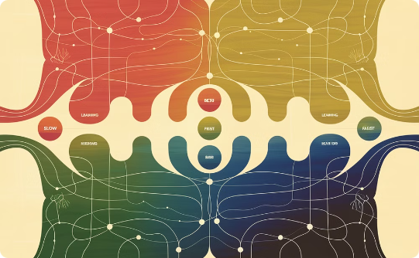
Learning Rates and Adaptive Optimization
Gradient Descent
Learning Rate
Adaptive Optimization
Gradient Descent is a fundamental optimization algorithm that iteratively updates model parameters to minimize a loss function. Learning rate controls the step size.
The learning rate dictates how quickly the model adapts to the data. It is a crucial hyperparameter influencing convergence and model performance.
Adaptive optimization methods adjust the learning rate dynamically based on the training process, promoting faster convergence and improved performance.

Slide 38

Bias-Variance Tradeoff
Bias measures the error caused by simplifying assumptions of a model. Variance measures the model's sensitivity to changes in training data.
A high-bias model underfits the data, while a high-variance model overfits the data.
The goal is to find a model with a good balance between bias and variance.

Slide 39




Regularization and Bias-Variance Tradeoff
Underfitting
A model that underfits has high bias, failing to capture the underlying patterns in the data.
Overfitting
A model that overfits has high variance, fitting the training data too closely and failing to generalize.
Bias-Variance Tradeoff
Regularization aims to find a balance between bias and variance, leading to better generalization.

Slide 40
Regularization in Deep Learning
Importance of Regularization
Regularization Techniques
Regularization helps prevent overfitting in deep learning models. Overfitting occurs when a model learns the training data too well, resulting in poor generalization to unseen data.
Weight Decay
Dropout
Batch Normalization
Early Stopping

Slide 41

Choosing the Right Regularization Technique
Model Complexity
Data Characteristics
Highly complex models are prone to overfitting, while simpler models may underfit. Choose regularization techniques that suit the model's complexity.
Data characteristics like noise, size, and distribution influence regularization choices. Consider these factors when selecting the right technique.
Performance Metrics
Hyperparameter Tuning
Evaluate models based on specific performance metrics. Choose regularization techniques that optimize for desired metrics.
Adjust hyperparameters like regularization strength to find the optimal balance between bias and variance.

Slide 42
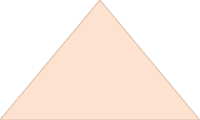
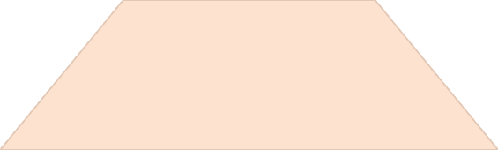
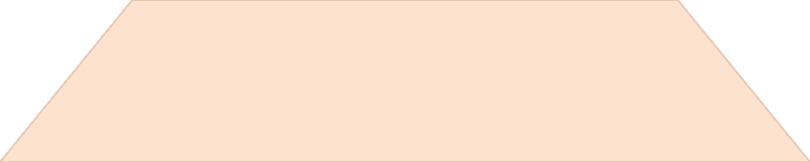
Hyperparameter Tuning and Cross-Validation
Hyperparameter tuning is essential for achieving optimal performance in machine learning models.
Grid Search
1
Systematically explore a range of hyperparameter values.
Random Search
2
Randomly sample hyperparameter combinations.
Bayesian Optimization
3
Use a probabilistic model to guide the search.
Cross-validation is a technique for evaluating the performance of a model on unseen data.
It helps to prevent overfitting and provides a more realistic estimate of the model's generalization ability.

Slide 43




Monitoring and Evaluating Model Performance
Metrics
Track key metrics, such as accuracy, precision, recall, and F1-score, to assess how well the model performs on unseen data.
Visualizations
Create visualizations like confusion matrices and ROC curves to gain insights into model behavior and identify areas for improvement.
Performance Dashboards
Develop dashboards to monitor model performance over time, identify trends, and proactively address issues.

Slide 44

Practical Considerations and Pitfalls
1
1. Over-Regularization
2
2. Hyperparameter Tuning
Too much regularization can lead to underfitting, hindering the model's ability to learn complex patterns.
Finding the optimal regularization strength requires careful experimentation and cross-validation.
3
3. Data Quality
4
4. Computational Cost
Regularization is less effective on noisy or incomplete data. Data preprocessing is essential.
Some regularization techniques, like dropout, can increase training time and complexity.

Slide 45

Real-World Applications of Regularization
Regularization plays a crucial role in various machine learning applications. It helps prevent overfitting and enhances model generalization. Regularization techniques are widely used in image recognition, natural language processing, and time-series analysis.
For instance, image recognition models use regularization to improve accuracy in classifying complex images. Similarly, in natural language processing, regularization aids in building robust language models for tasks like machine translation and sentiment analysis.

Slide 46
Conclusion and Key Takeaways
Regularization is Crucial
Choose the Right Technique
Regularization is a powerful technique that helps avoid overfitting and improves the generalization performance of machine learning models.
Weight decay is effective for reducing complex models.
Dropout helps prevent co-adaptation and improves model robustness.

